Slide 1
Thrust Stand Measurements Using Lasers
Kyle Stanevich

Slide 2
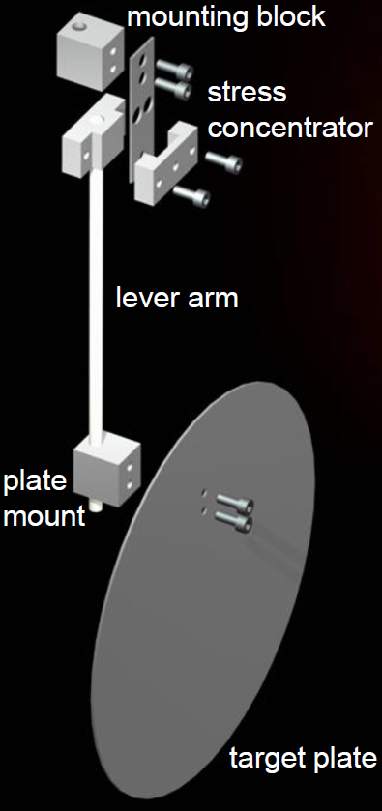
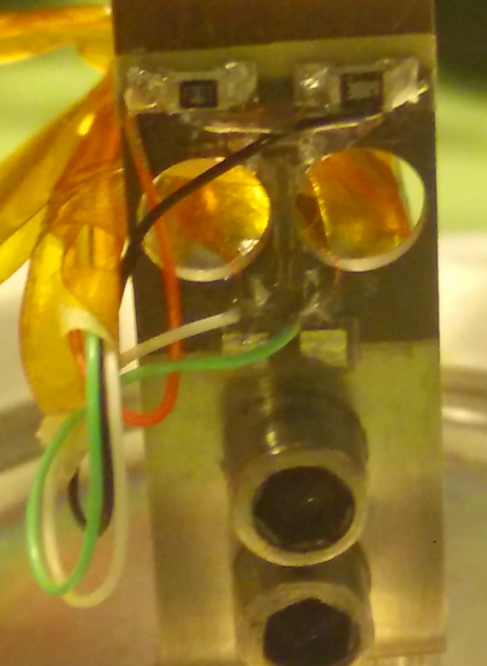

Strain Gauge Design
Measured change in voltage of strain gauges to find displacement
Used COMSOL simulation to relate displacement to force
The device no longer works because the strain gauges broke
Questionable accuracy and range of measurements
Notes:
Design from 2013 Ulmen Thesis

Slide 3
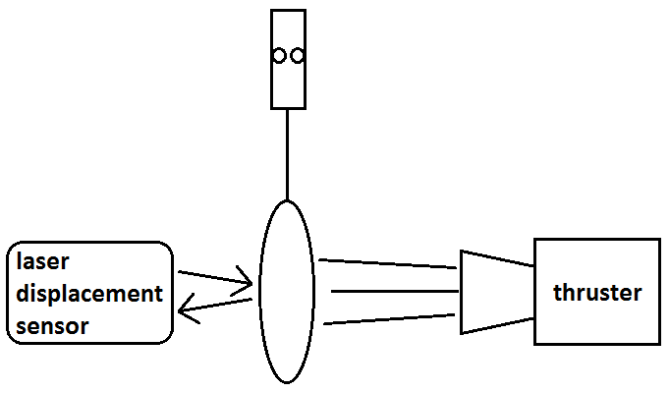
Previous Laser Proposal
Measure displacement using a laser
Use same plate as strain gauge design
Could it work in our conditions?
Is the resolution small enough?
Notes:
Design from 2016 independent study final paper by Kyle Stanevich prepared for Dr. Miley and Drew Ahern

Slide 4
Alternative Design
Measure angle displacement of laser
Amplify angle using a long laser path and series of mirrors
Would the deflection be large enough to measure?
Relate this distance to force
laser

Slide 5
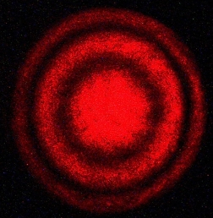
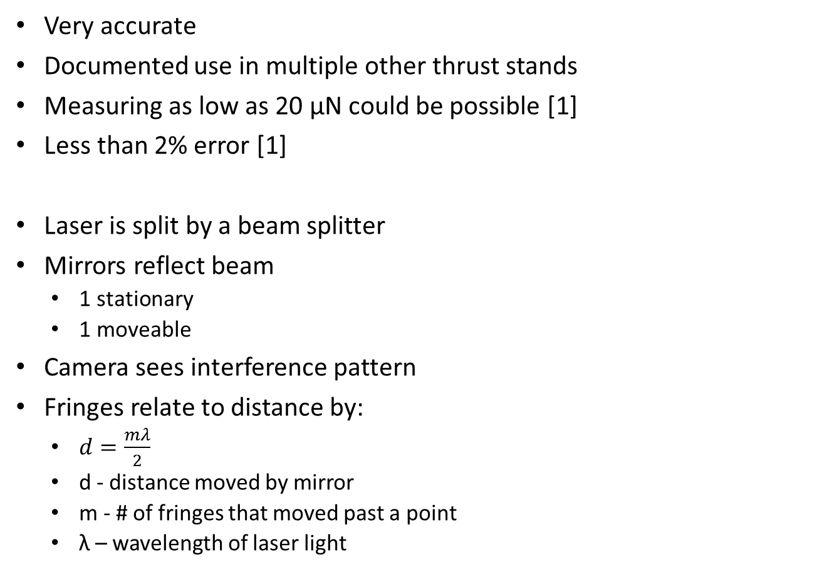
Michelson Interferometer
Very accurate
Documented use in multiple other thrust stands
Measuring as low as 20 μN could be possible [1]
Less than 2% error [1]
Laser is split by a beam splitter
Mirrors reflect beam
1 stationary
1 moveable
Camera sees interference pattern
Fringes relate to distance by:
$d=\frac{mλ}{2}$
d - distance moved by mirror
m - # of fringes that moved past a point
λ – wavelength of laser light
laser
camera
Notes:
Specifications from [1]
Equation from http://hyperphysics.phy-astr.gsu.edu/hbase/phyopt/michel.html
Picture (top right) from http://web.physics.ucsb.edu/~lecturedemonstrations/Composer/Pages/84.30.html

Slide 6
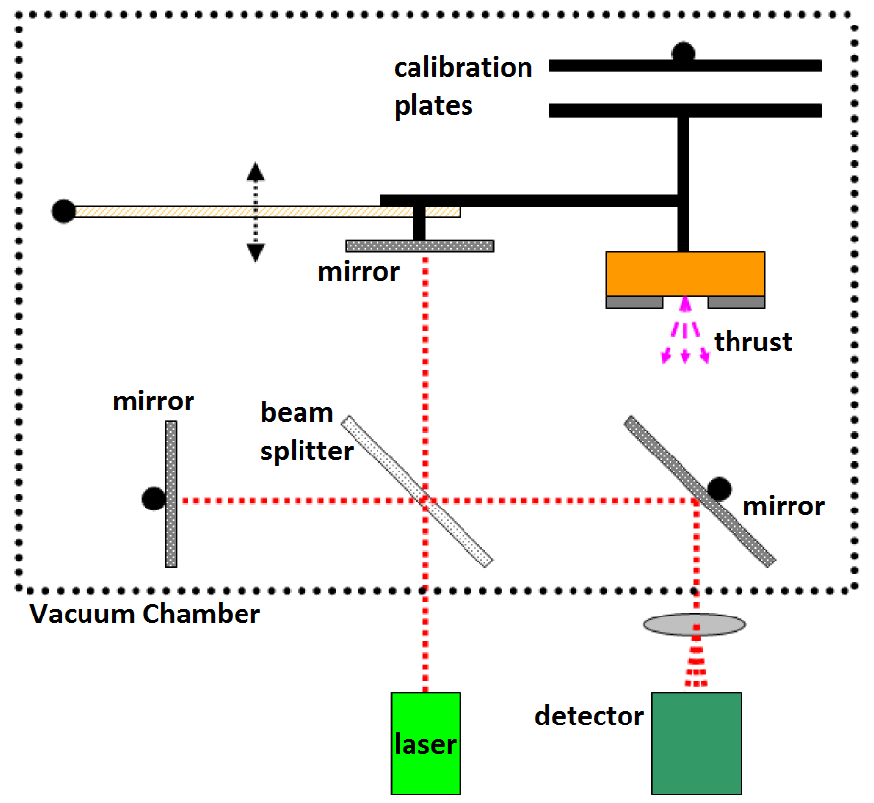
Kovaleski and Kemp
Notes:
Diagram from [2]

Slide 7
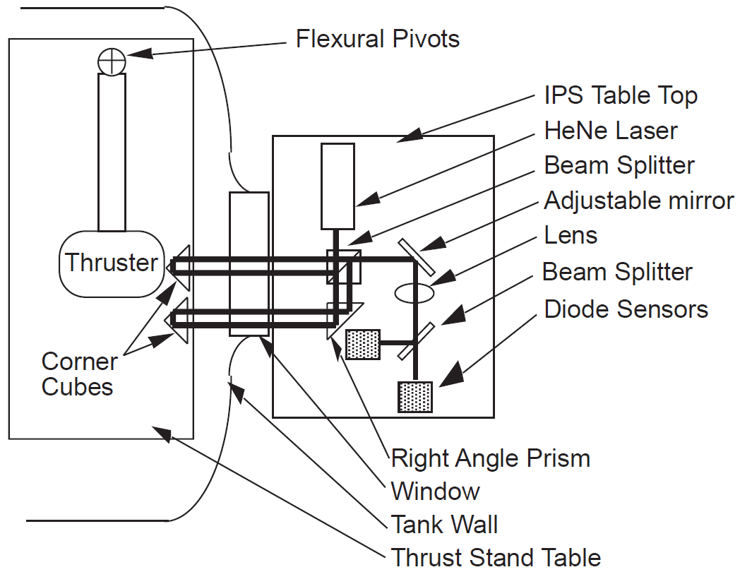
Cubbin
Notes:
Diagram from [1]

Slide 8
In Our System
laser
window
beam splitter
camera
beam expander
mirror on pendulum
mirror
mirror
chamber wall

Slide 9
Parts and cost
Some parts might be found around the lab
Part | # | Cost | Link
Laser (collimated round beam class 3R) | 1 | $90 | https://www.thorlabs.com/newgrouppage9.cfm?objectgroup_id=1487
Beam splitter (1/2” cube 50:50) | 1 | $165 | https://www.thorlabs.com/newgrouppage9.cfm?objectgroup_id=754
Mirror (1” diameter) | 3 | $18 | https://www.newport.com/f/float-glass-utility-broadband-metallic-mirrors
camera | 1 | $100 | Any digital camera
Optical breadboard (12”x12”) | 1 | $151 | https://www.thorlabs.com/newgrouppage9.cfm?objectgroup_id=159
Beam expander (plano concave lens 1” diameter) | 1 | $20 | https://www.thorlabs.com/newgrouppage9.cfm?objectgroup_id=2087
Miscellaneous mounting equipment | ? | $100
Total estimated price |  | $680

Slide 10
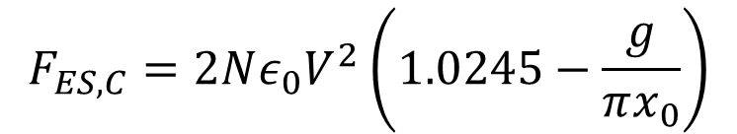
Calibration
$$F_{ES,C}=2Nε_{0}V^{2}\left(1.0245−\frac{g}{πx_{0}}\right)$$
Force comb
Applied voltage generates an electrostatic force
Minimal dependence on comb separation distance
thrust plate
V
Notes:
Equation from [4]
Picture (left) from [3]
2*g is distance between comb prongs
2*c is width of comb prong
Equation on slide is for when g=c
N - number of prongs
V - voltage applied
2*x₀ - prong overlap distance

Slide 11
Force Comb
Notes:
Graph from [4]

Slide 12
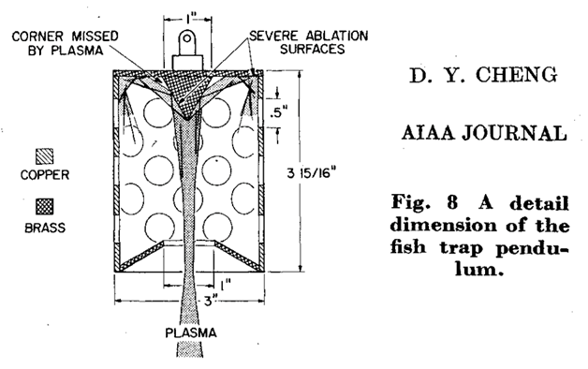
Considerations
Damping
Heavy base
Rubber below all equipment
Ensure pendulum natural frequency is not close to vibrations
Cup to catch exhaust
Notes:
Picture from [5]

Slide 13
References
Thrust Measurements Using Laser Interferometry, Edward A. Cubbin, April 29, 1998
Thrust and Specific Impulse Measurements of the Ferroelectric Plasma Thruster, Scott D. Kovaleski and Mark A. Kemp, 21 July 2008
Micronewton Thrust Balance for Indium FEEP Thrusters, K. Marhold and M. Tajmar, 10 July 2005
Comparison of force balance calibration techniques for the nano-Newton range, Nathaniel P. Selden and Andrew D. Ketsdever, 23 July 2003
D. Y. Cheng, AIAA Journal

